Slide 1

MAP and SOA
Kinetium Inc.
Notes:
Structure
A little more method overview
Add “Basic Modeling”: objects + actions → info + behavior models (without any diagrams??)
Add fully-worked, tiny case study as posters
Include notation summaries
Main structure should reflect new method documentation

Slide 2
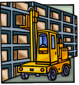



Goals, Components, Concerns
7: Multiple relevant concerns: function, security, technology
2: Goal - Factories supplied just in time from supplier warehouses
Functionality
Security
Performance
Technology
…
1: Problem Domain – factories, supplies, warehouses, partners, existing systems
3: Refinement to sub-goals + domain facts – track inventories, predict production load, optimize supply scheduling, make deliveries
4: Scope of sub-goals get narrower.
Some assigned to components.
production load predictions
supply scheduling
supplier
inventory
deliveries
scheduling
predictions
5: Applications, Components, Connectors
– specifications for each one
– end-to-end satisfaction of goals
6: Applicable to any granularity of goals and components

Slide 3
MAp Viewpoints
Information supports goals, process
Process supports goals
Domain / Biz
Architecture
1
Outside
Domain: Information
Goals
Biz. Process
Goals – success criteria
Black box assembly includes S,
Supports business model
Traceability
Black box Assembly (including S)
Component Architecture
Black box Spec (of S)
S
1
S
1
S
2
E
D
S: Information
Boundary
Architecture Styles: Principles, Patterns, Guidelines, Rules
Black-box Specification (of S)
4
S: Behavior
3
Black box view of S
Architecture styles, patterns: across viewpoints, projects
White box view of S
sub-component s1…s3
Partitions behavior & information
1
2
S
S
Component Architecture
White box design (of S)
s2
Inside
s2
s1
3b
s1
s3
3a
s3
4
Information
Behavior
Each sub-component could be drilled-down if needed

Slide 4
(1) Define "Business Component" to mean the business equivalent of a software component: i.e. a bundle of [humans, manual+automated processes, technical systems, other resources] that is usefully encapsulated and treated as a unit, with goals, b-boxes, services, etc. Business components are fractal, as you would expect.
Dependencies across these start at the goals levels (X has a goal it would like to meet, and X needs some help from Y to meet that goal).
(2) Explicitly show that each large grain Business Component (e.g. Sales) is "multi-tiered" in a purely business sense, with:
- Case Co-ordination Strategy elements that
- Execute Coordinate Plan & Strategize (respectively)
(3) Use 1&2 above as one way to locate different SOA-related offerings.

Slide 5
Business Components
Dashboard
match and combine
at goals level
market
segments
product
portfolio
markets
business goals
segments
product
portfolio
Strategy
Co-ordination
Case
resource
allocator
portfolio
recommendations
recommendations
customer

Slide 6



An E-Business Snapshot
marketing
portal
portal
supplier
employee
customer
sales
Biz process
service
out-source
in-source
partners

Slide 7


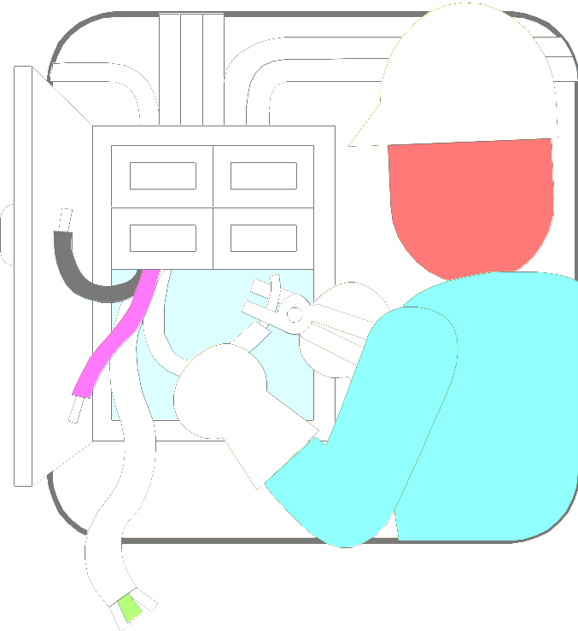
Portals
marketing
portal
portal
supplier
employee
customer
sales
service
Biz process
out-source
in-source
Insider view of inside and outside
Outsider view of inside and outside
Customized, personalized

Slide 8
Data Integration
marketing
portal
portal
supplier
employee
customer
sales
service
Biz process
Heterogeneous data sources
Syntactic and format differences
Semantic differences and inconsistencies
Internal and external data
out-source
in-source

Slide 9
Application Integration
marketing
portal
portal
supplier
employee
customer
sales
service
Biz process
out-source
in-source
“Live” coordination across applications
Complex heterogeneous distributed transactions
Internal and external

Slide 10
Business Process Integration
marketing
portal
portal
supplier
employee
customer
sales
service
Biz process
out-source
in-source
Complex end-to-end value chains
Conceptually simple changes cannot be implemented
Arbitrary business operations out-source / in-source

Slide 11
Business Process Optimization
marketing
portal
portal
supplier
employee
customer
sales
service
Biz process
out-source
in-source
Holistic measurement of processes
Track all processes, data, events
Analyze, recognize, improve … Survive … Thrive
Internal and external

Slide 12
The Need
A single integrated model across the E-enterprise
Product and market strategy
Customer response time
Supply chain efficiency
Immediate information access
Customer’s inventory policy change
Changes in Supplier’s Process
A simple but loaded statement
What does “single integrated model” imply?

Slide 13
The “Integrated E-Enterprise”
An enterprise whose multiple, distributed, and possibly virtual ...
  goals and strategies (acquisition, technology, ...)
  business areas (accounting, marketing, ...)
  architectures (software infrastructure, biz, ...)
  operations and processes (workflows, systems, rules, ...)
  automated systems (legacy, new; built, bought, ...)
  data, information, people (databases, DSS systems, ...)
  and the organization's understanding of all of these …
… form a cohesive, managed, and adaptive whole

Slide 14
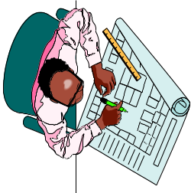

Two Dimensions for Integration
? Common understanding? Shared vocabulary?
Models
Strategies
Spreadsheets
Processes
Apps, Data
Horizontal variation
Vertical
variation
Strategy
Process
Apps
Data
IT
engineering
marketing
sales
service
? Integrated Systems and Data ?

Slide 15
Models - Many Levels and Kinds
Different kinds of models
Different e-partner views
Strategy
Spreadsheets
QFD Matrices
Balanced Scorecard
Processes
Connect
Business
to technology:
Relate
Concrete
to
Abstract
Business Processes
Procedures
IT
engineering
Information Models
Applications
marketing
Application Specs
service
sales
Components, Objects
Application Architecture
Databases
Cobol Records
Database Models
Networks
Networks
Manage Change

Slide 16
Enterprise Models- Challenges
Federation - separate views with dependencies
Package
Package
Integration -
horizontal
Package
Package
Package
& vertical
Combined
engineering
IT
marketing
sales
service
Package
Package
refine
Combined
Seamless - from biz to code
Architecture - frameworks for
consistent shared models, patterns
Object-Relational map
Synchronization - between
all models and “biz world”
Service-Level Agreement

Slide 17
What It Is
Enterprise Engineering is
  the modeling, design, operation, and evolution
  … of all aspects of an (e-)enterprise
  … using engineering methods and tools
  … to effectively achieve goals and objectives

Slide 18
Roles of Models in the Engineered Enterprise
(5) Deploy via models
Human
Software
Models
Strategy
Process
Systems
Data
Model of business
+ mappings to “world”
Operate
(1) Data, events
Manage/Evolve operations
(2) Analyze to infer model
Analyze, monitor, animate
(3) Animate model with real data
(validate, find rule violations, predict)
Plan
(4) Envision, plan, evaluate impact, build

